Slide 1
Credit Rating Version 3
Method applied:
1/ Principal Component Analysis
2/ K-Means Clustering
3/ Linear Interpolation
January, 2021

Slide 2
What’s new from version 2?
Principal component analysis is conducted prior to K-Means algorithm to remove double effect
Linear interpolation is applied to estimate data points between modeled centroids

Slide 3
Section 1:
Credit Scoring on Major Stocks

Slide 4
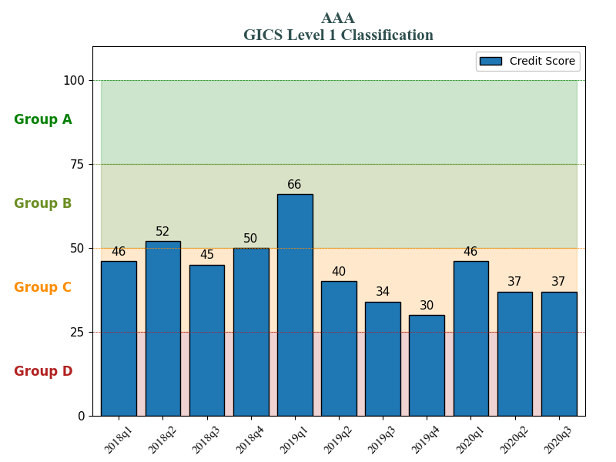
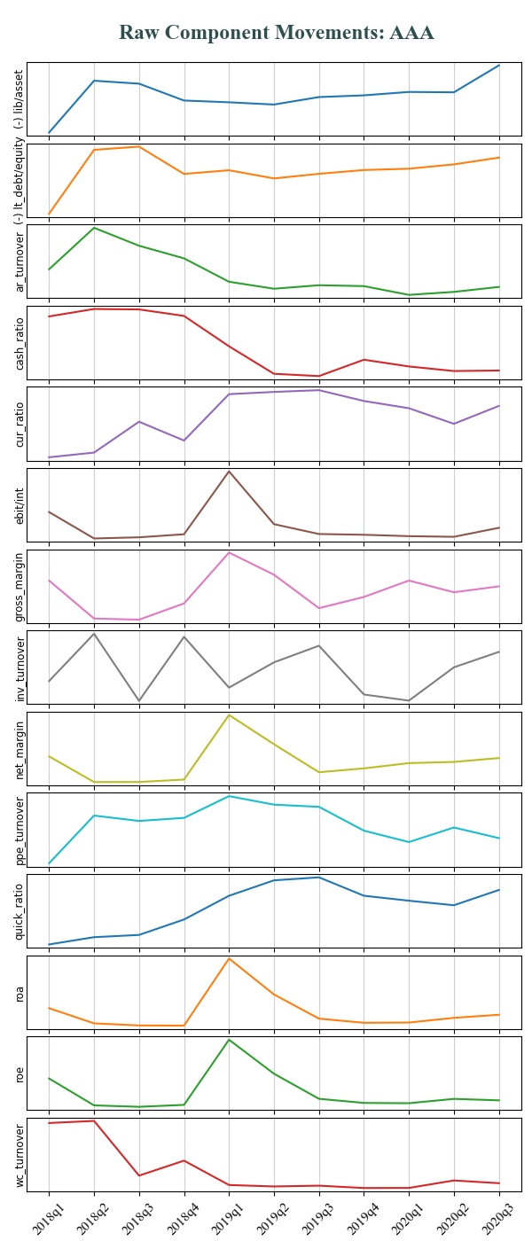
Remark:
1/ Credit score of AAA was relatively stable with the exception of the sudden surge in 2019q1
2/ Further breakdown showed that, this upsurge was mainly supported by rapid improvement in profitability-related components, including EBIT/Interest, Gross profit, Net margin, ROA, ROE.
3/ The slight decline witnessed from 2019q2 to 2019q4 was mostly because decreasing downtrend in most of the components

Slide 5
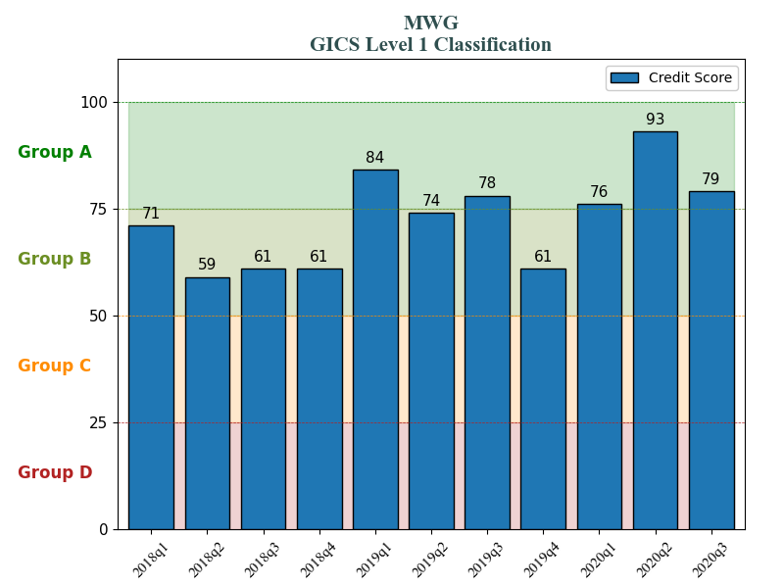
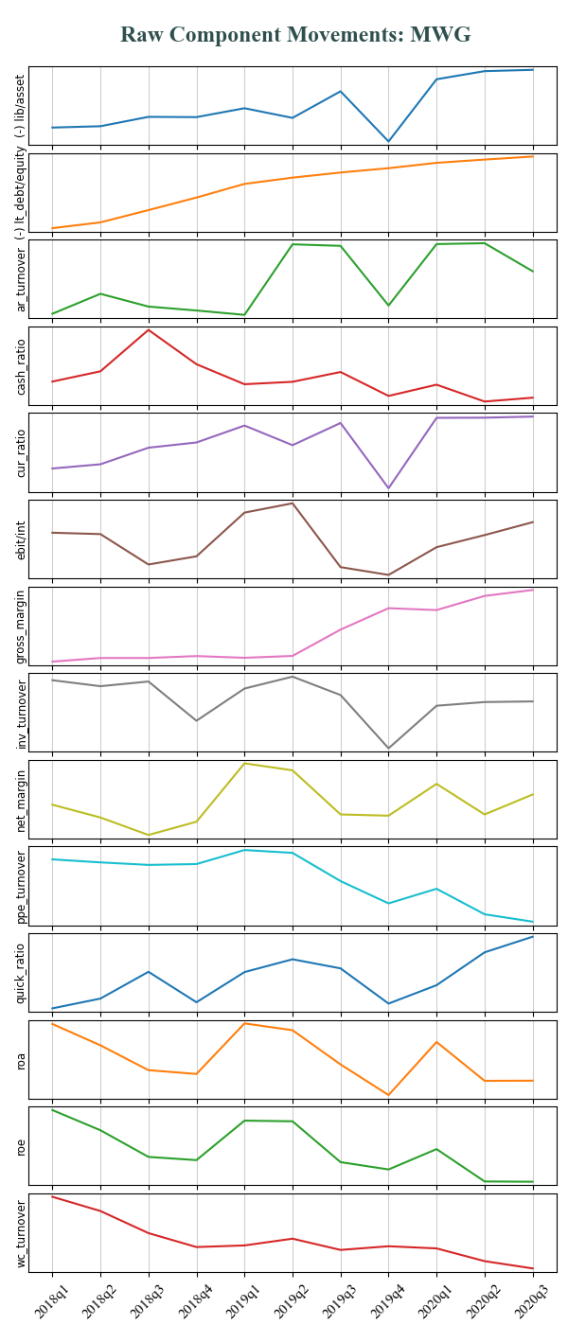
Remark:
1/ Credit score of MWG lifted in 2019q1, significantly dropped in 2019q4 and eventually peaked in 2020q2
2/ Further breakdown showed that, 2019q1’s upsurge was mainly supported by rapid improvement in efficiency-related components, including Account receivable turnover, Inventory turnover, PPE turnover, Quick ratio. On top of that, such profitability-related components as EBIT/Interest, ROA, ROE also helped the growth
3/ The sudden plunge in 2019q4 was primarily due to worsened working capital management, revealed in plummeted Account receivables turnover, Cash ratio, Current ratio, Inventory turnover, Quick ratio
4/ The spike in 2020q2 was mainly fueled by better capital structure (exhibited by Liability/Total asset), excellent working capital management (high Account receivables turnover, Current ratio, Inventory turnover, Quick ratio

Slide 6
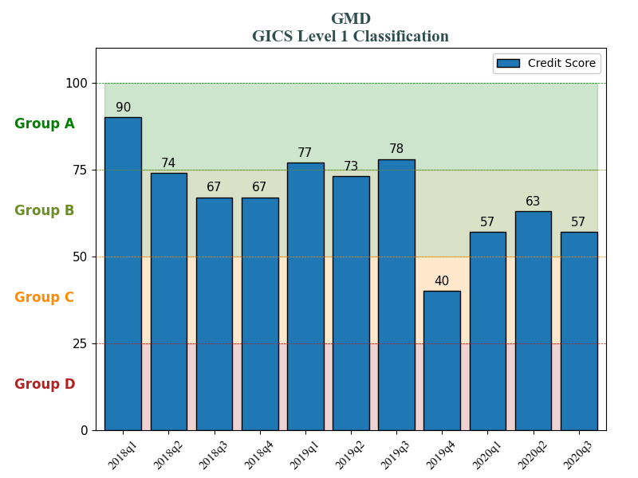
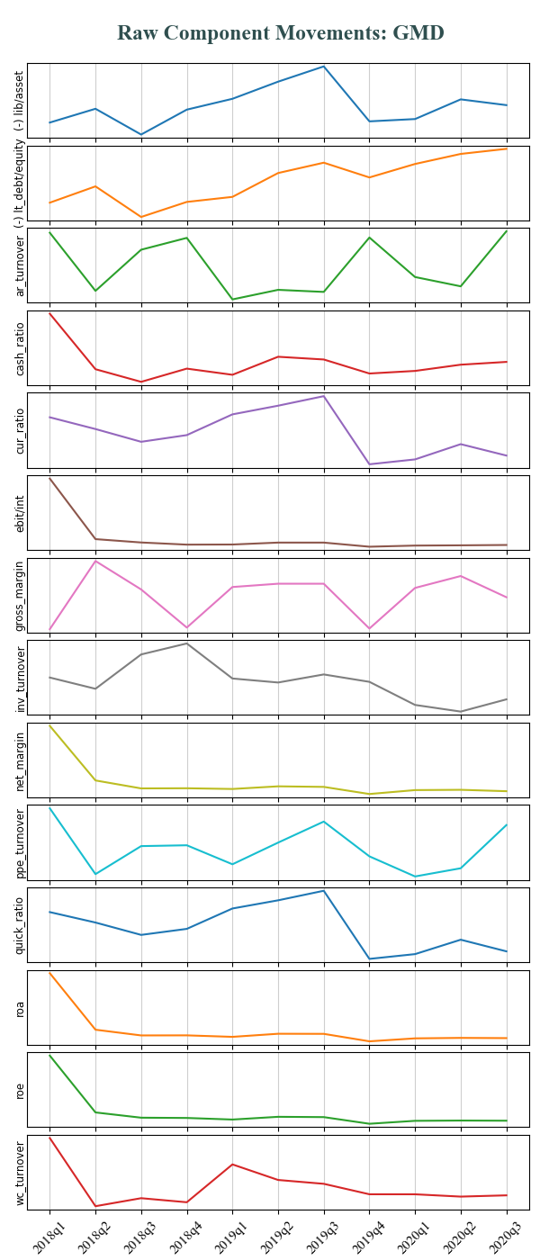
Remark:
1/ Credit score of GMD was relatively stable until the serious drop in 2019q4 and it seems never have the same performance since then
2/ Further breakdown showed that the severe drop was mainly due to poor working capital management (as exposed by Current ratio, Quick ratio), compressed profitability (seen in Gross margin, ROA, ROE), heavy investments (shown by PPE turnover)

Slide 7
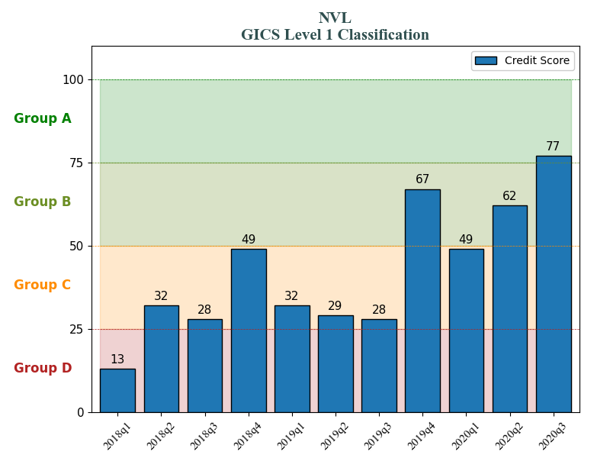
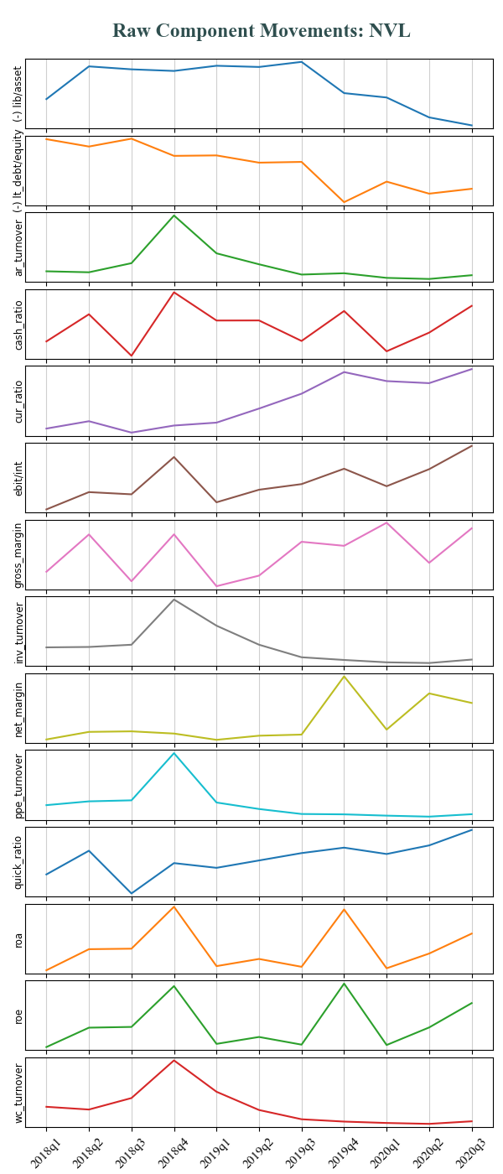
Remark:
1/ Credit score of NVL significantly improved in 2018q4 and 2019q4
2/ Further breakdown showed that 2018q4 upsurge was mainly supported by considerable improvement in efficiency-related and working capital management components, including Account receivable turnover, Cash ratio, Inventory turnover, Quick ratio, Working capital turnover. On top of that, boosted profitability also helped the growth, proved by Gross margin, ROA, ROE
3/ Another breakdown showed that 2019q4’s spike was primarily driven by profitability components including net margin, gross margin, ROA, ROE

Slide 8
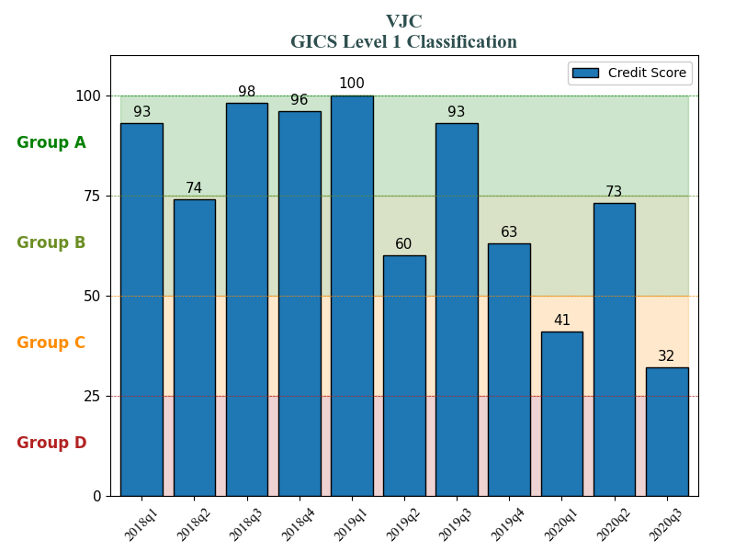
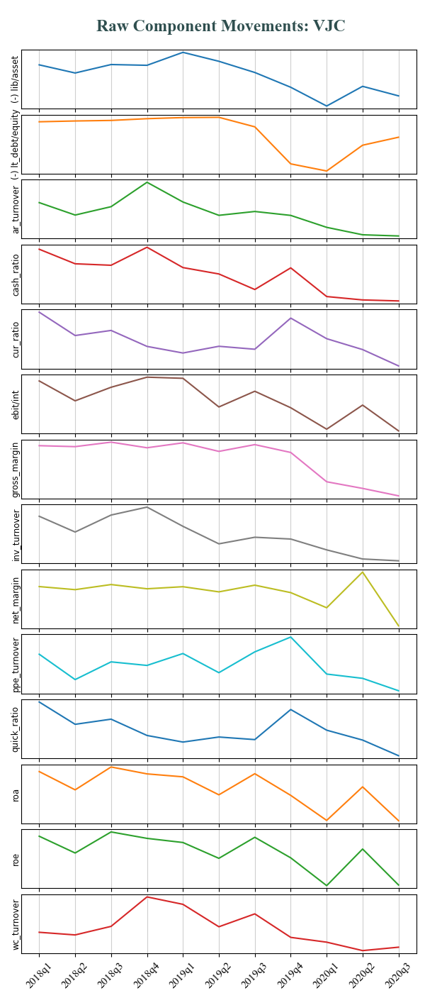
Remark:
1/ Credit score of VJC was downtrend generally since exceptional performance in early periods
2/ Further breakdown showed that VJC had excellent credit score during the year of 2018 mainly because of its great capital structure (showed in Liability/Total asset, Long-term debt/Equity, consistently positive working capital management and efficiency (as showed in Account receivables turnover, Cash ratio, Current ratio, Inventory turnover, Quick ratio). Profitability also supported the growth (as showed in Net margin, Gross margin, ROA, ROE, EBIT/Interest)
3/ Financial circumstance of the company gradually gets worse due to the decline in almost all investigated components since 2019q1

Slide 9
Section 2:
Credit Scoring on Dead Stocks

Slide 10
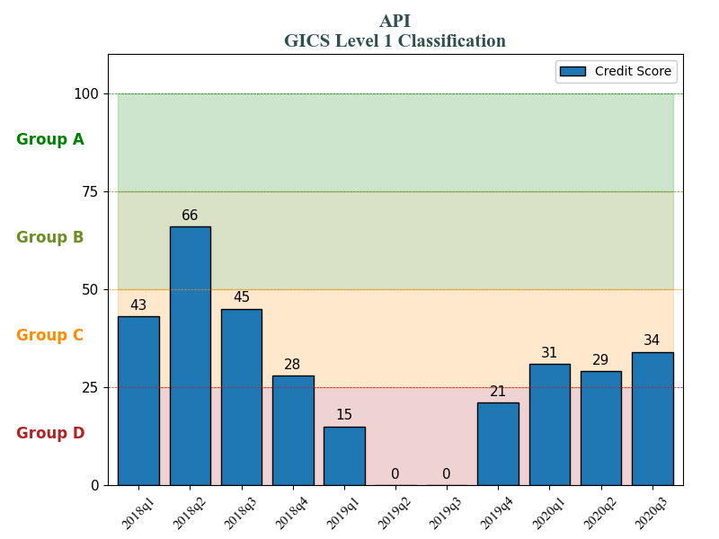
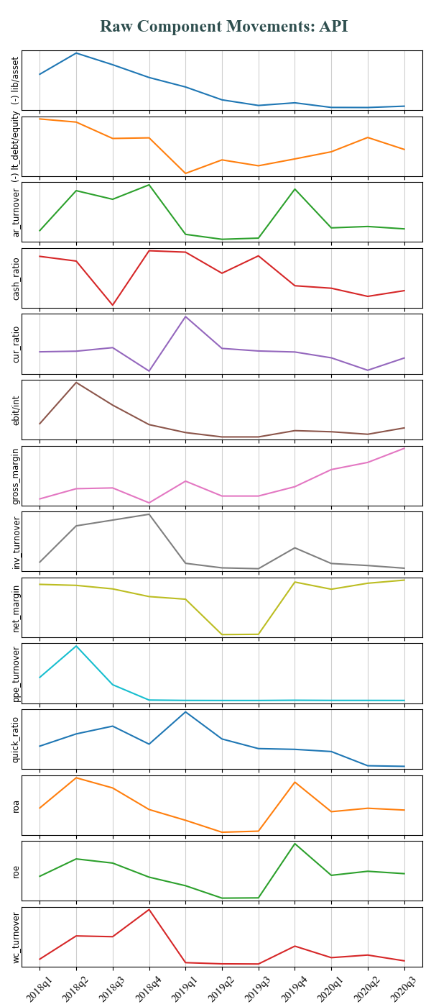
Remark:
1/ API dropped 50% in 2019q3
2/ Deteriorated financial circumstance was reflected in financial statements and hence, this model well predicted the crash since 2019q2

Slide 11
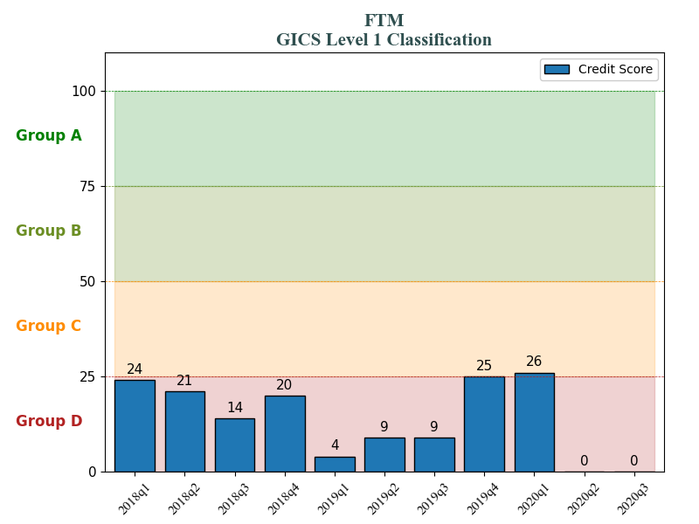
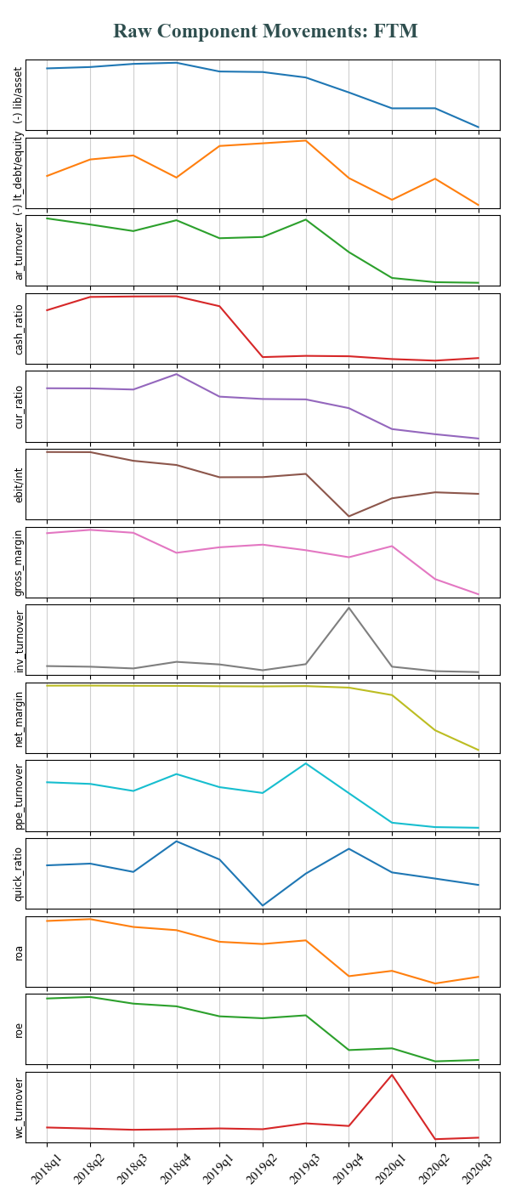
Remark:
1/ FTM dropped 90% in 2019q3
2/ Deteriorated financial circumstance was reflected in financial statements and hence, this model well predicted the crash since 2019q1

Slide 12
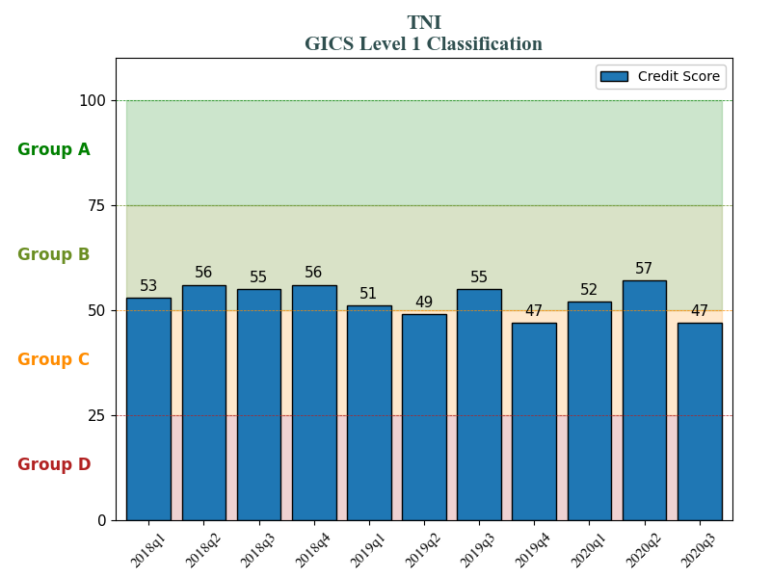
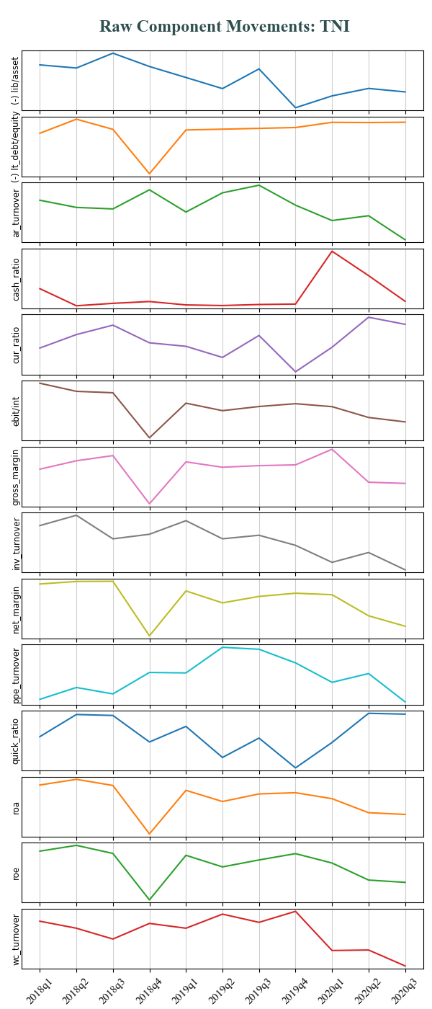
Remark:
1/ TNI dropped 75% in 2020q2
2/ Somehow their financials remained good and this model failed to predict anything

Slide 13
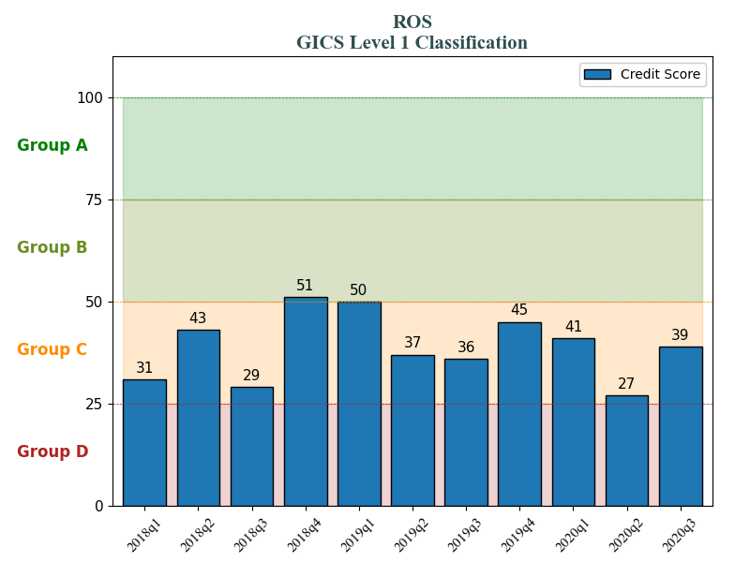
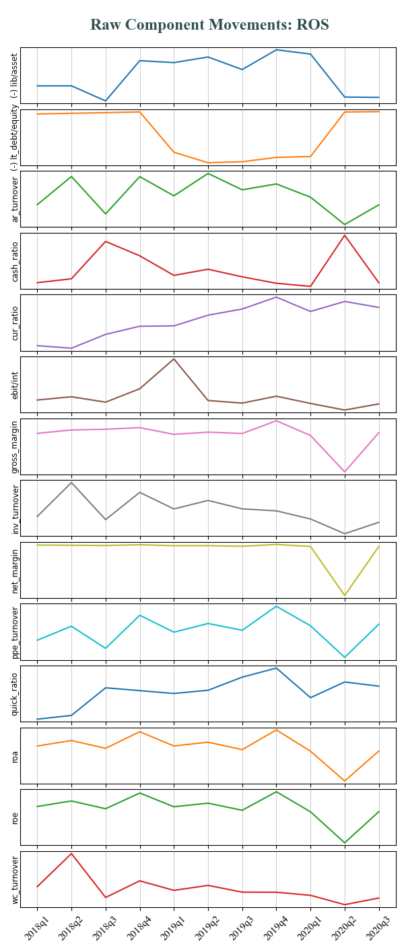
Remark:
1/ ROS dropped 70% in 2020q1
2/ Somehow their financials remained average and this model failed to predict anything

Slide 14
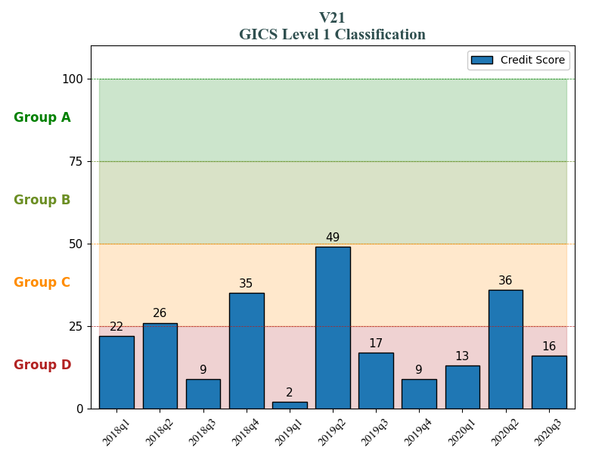
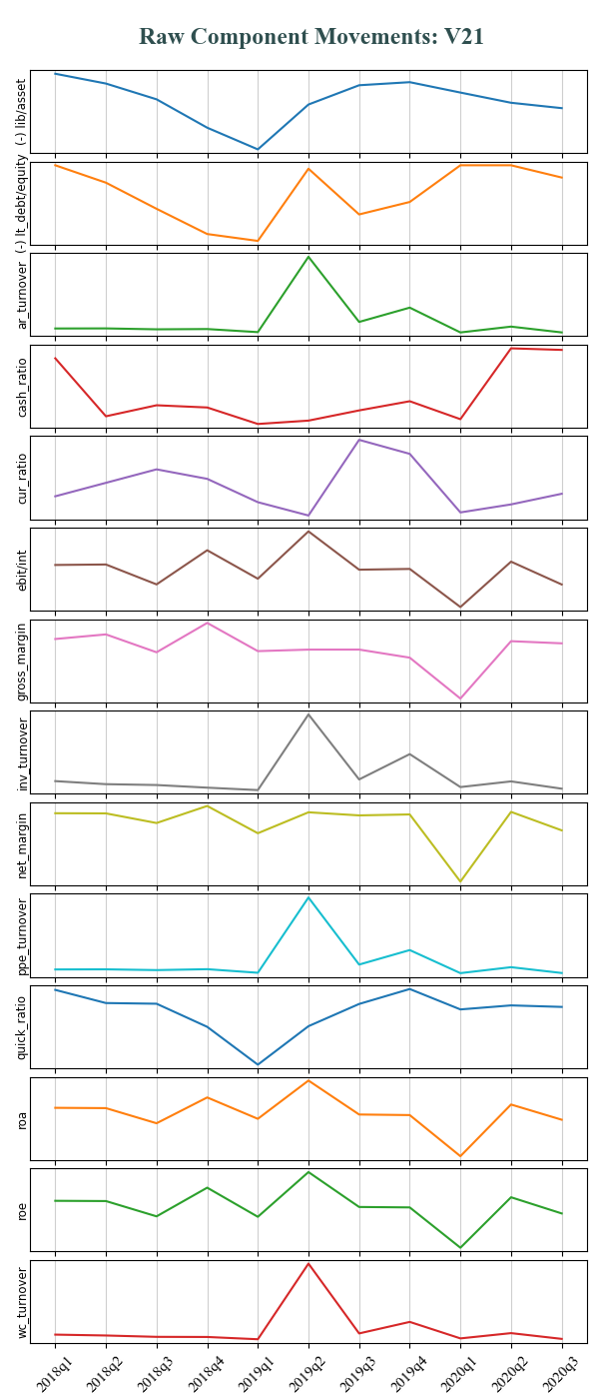
Remark:
1/ V21 dropped 75% in 2020q2
2/ Deteriorated financial circumstance seemed to be partly reflected in financial statements. This modeled suggested inconsistent variation of the company’s financial reports and, in some sense, predicted the crash since 2019q1

Slide 15
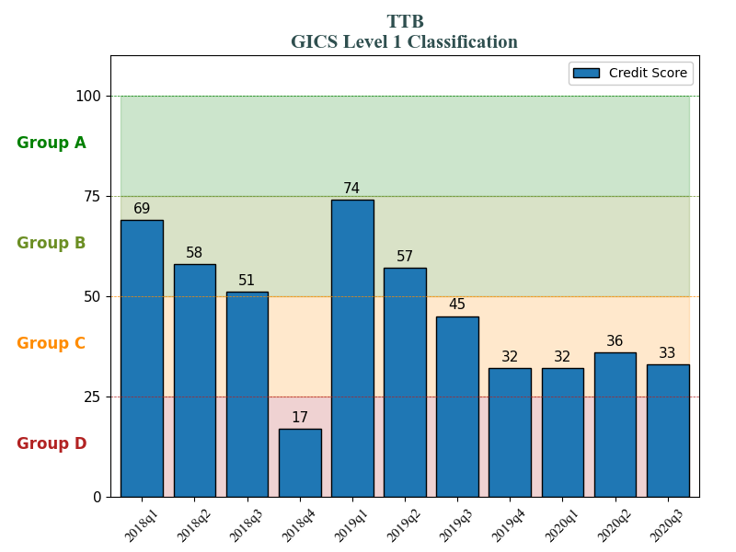
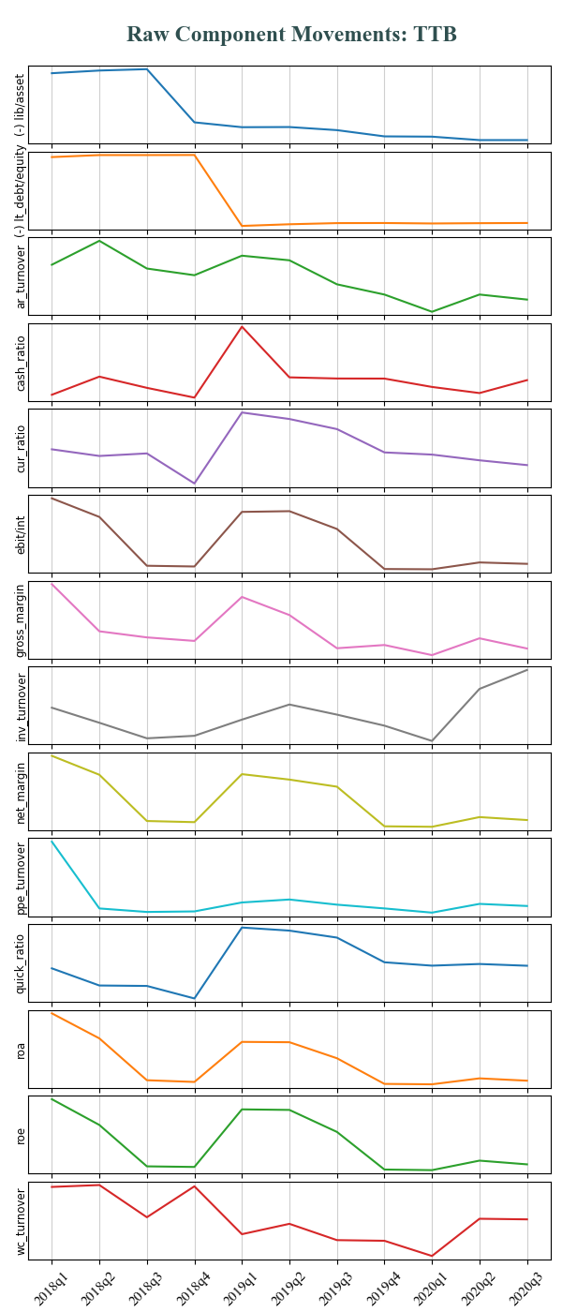
Remark:
1/ TTB dropped 75% in 2019q4
2/ This model suggested worsened financial health of the company, but it had not delivered an absolute prediction

Slide 16
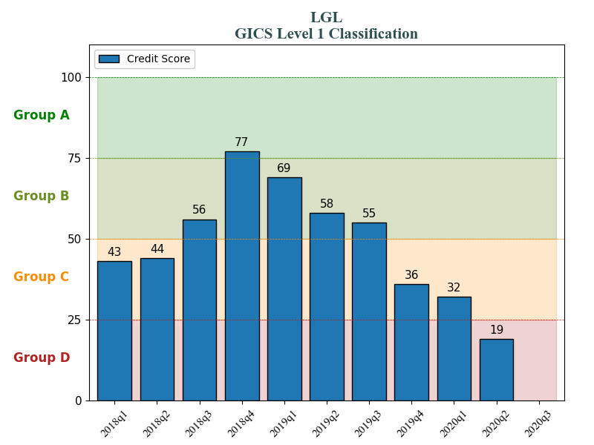
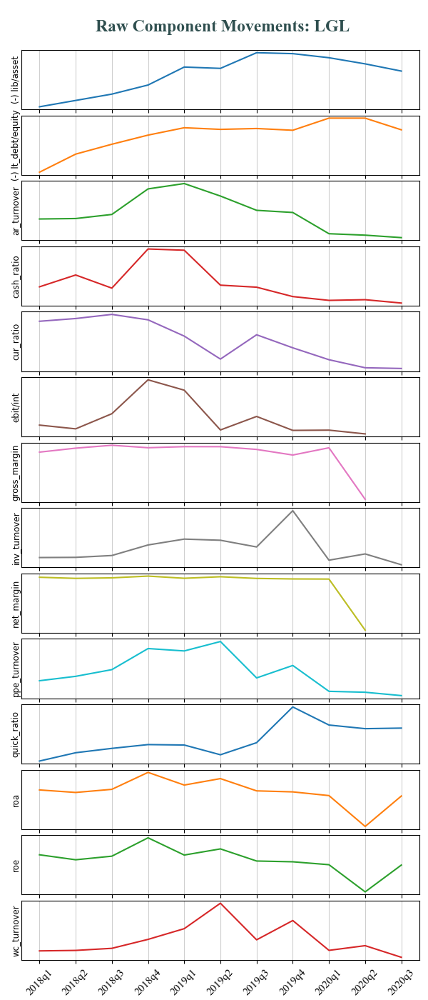
Remark:
1/ LGL dropped 50% in 2020q1
2/ This model suggested worsened financial health of the company, but it had not delivered an absolute prediction

Slide 17
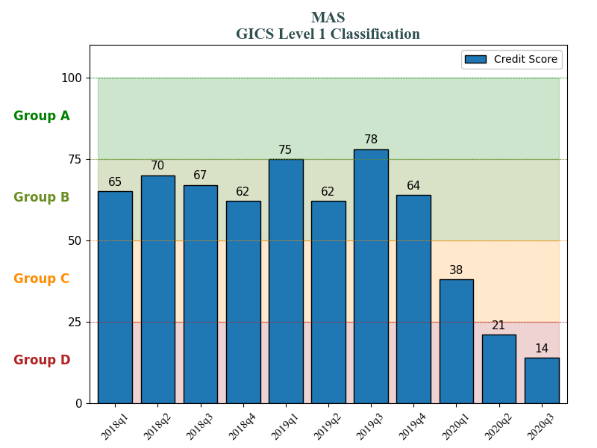
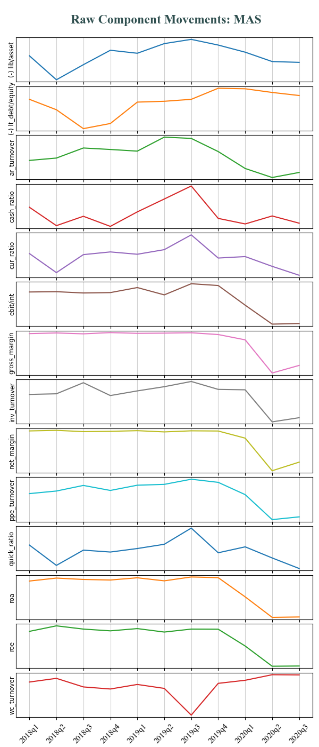
Remark:
1/ MAS dropped 50% in 2020q1
2/ This model suggested worsened financial health of the company, but it had not delivered an absolute prediction

Slide 18
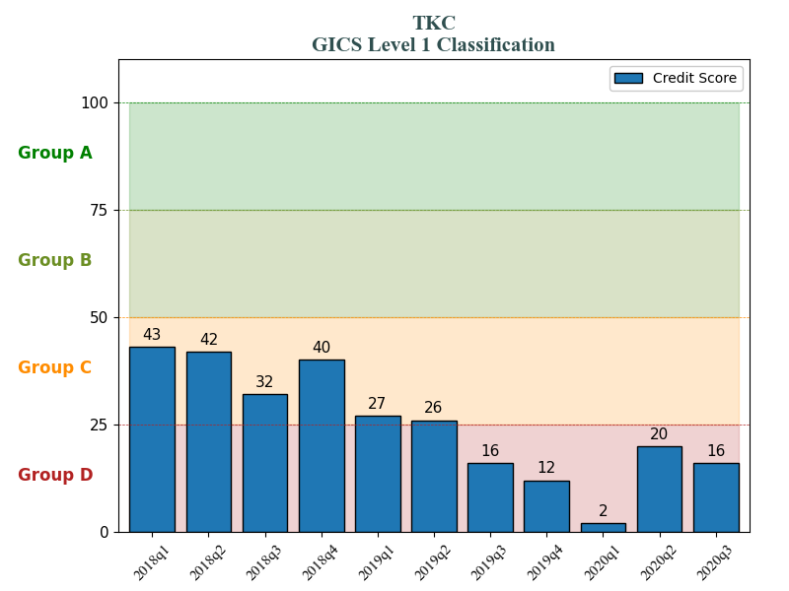
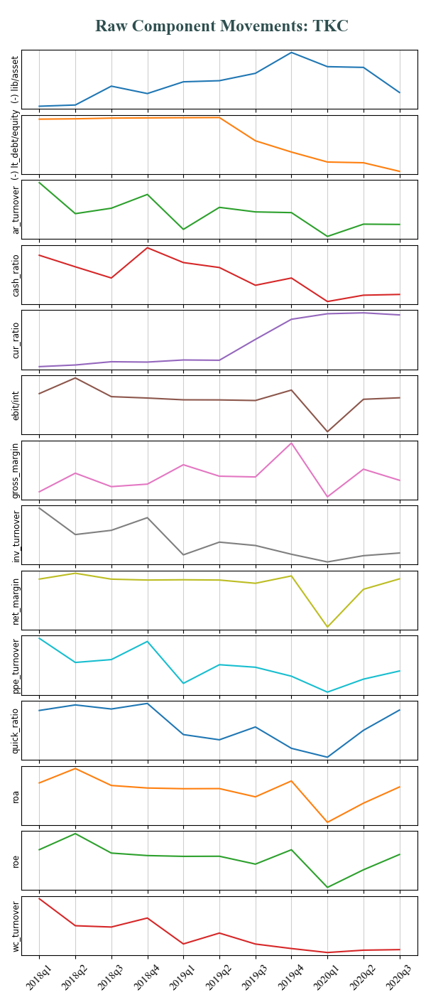
Remark:
1/ TKC dropped 85% in 2019q4
2/ This model suggested worsened financial health of the company, but it only delivered a clear prediction until 2020q1

Slide 19
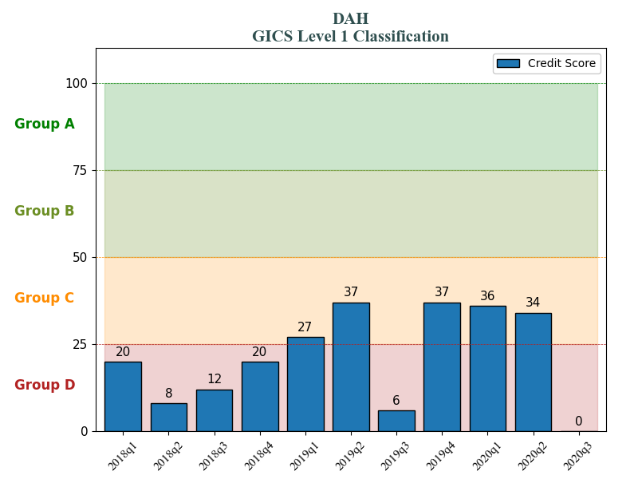
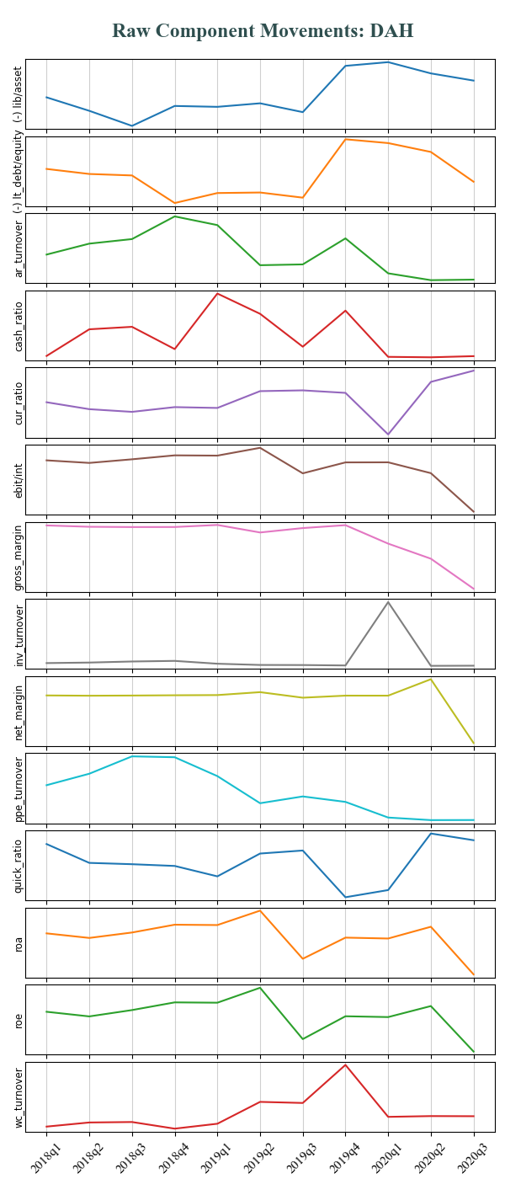
Remark:
1/ DAH dropped 80% in 2020q3
2/ This model had suggested some suspicious signal since 2019q3

Slide 20
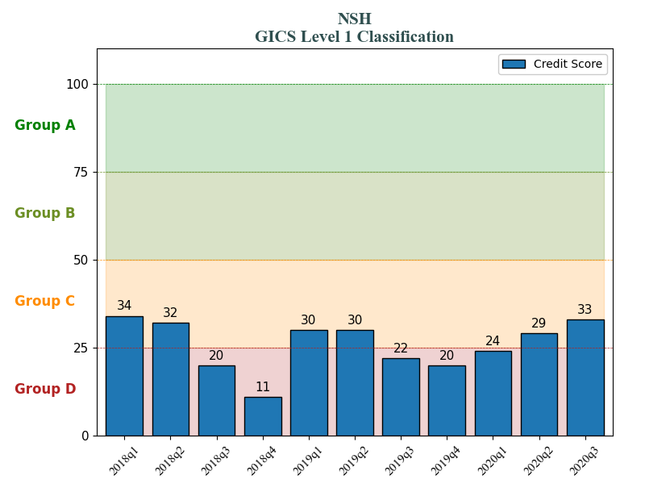
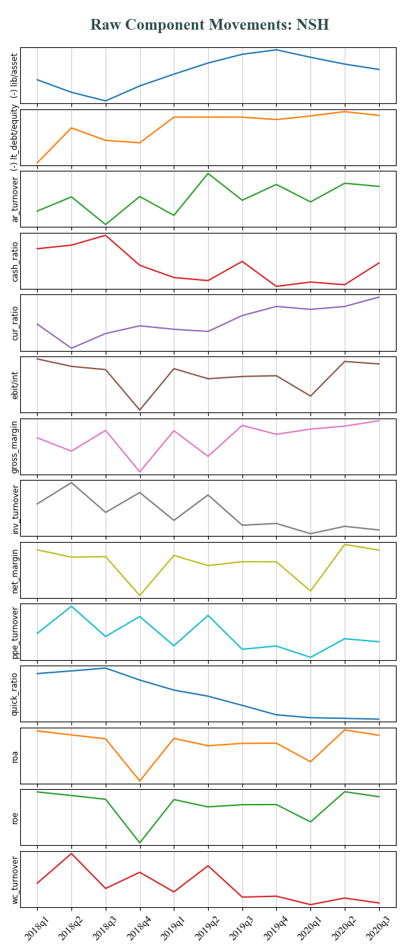
Remark:
1/ NSH dropped 80% in 2018q4
2/ Deteriorated financial circumstance was well reflected in financial statements and hence, this model well predicted the crash since 2018q3

Slide 21
Section 3:
Comparison with
Current Method

Slide 22
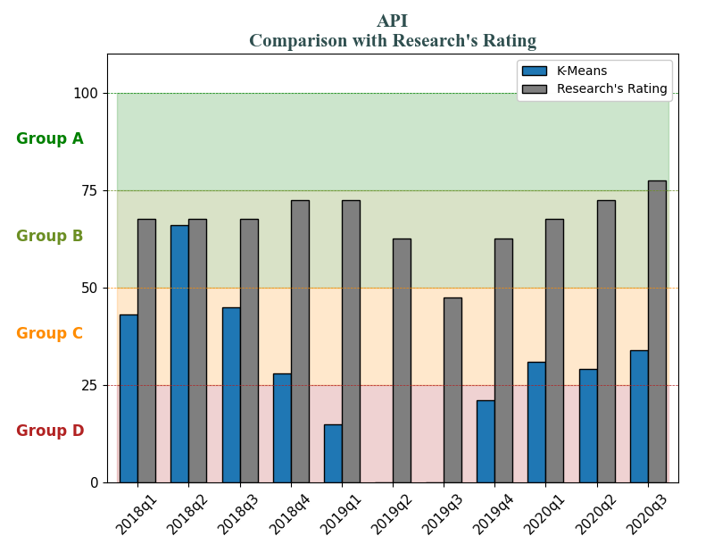
API dropped 50% in 2019q3

Slide 23
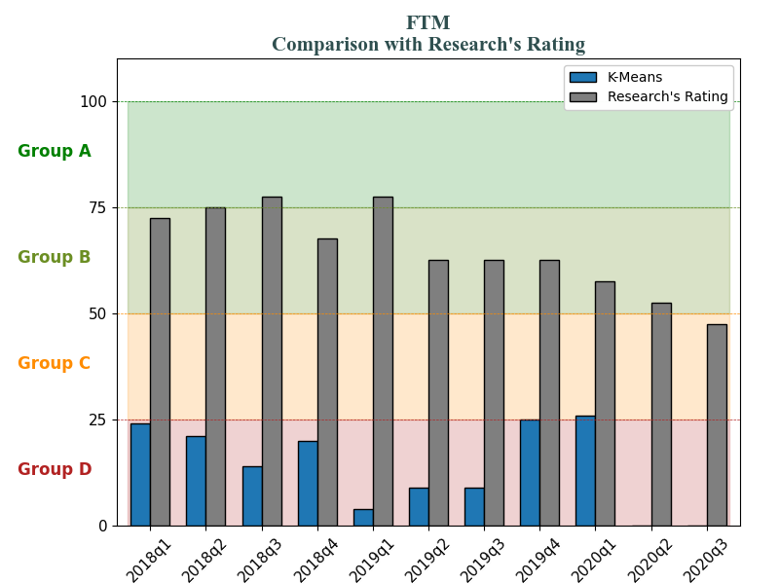
FTM dropped 90% in 2019q3

Slide 24
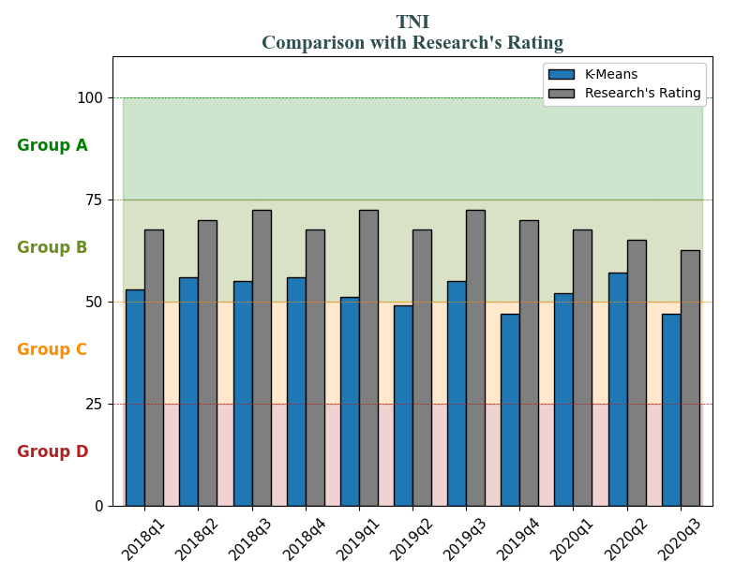
TNI dropped 75% in 2020q2

Slide 25
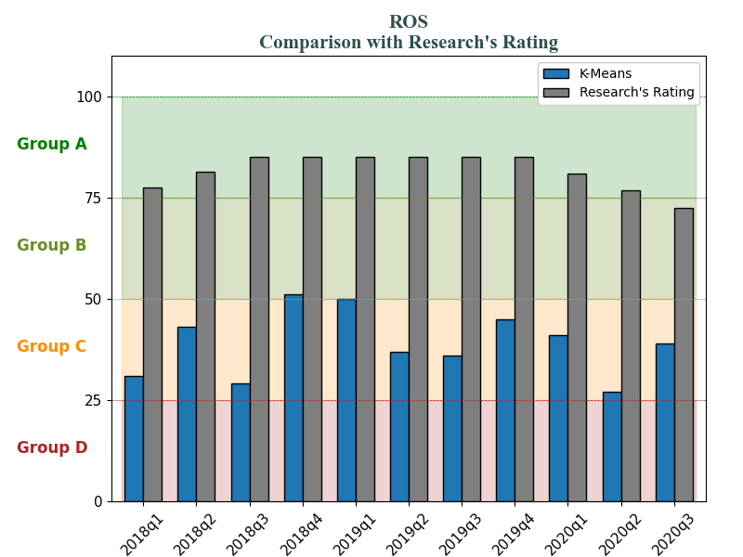
ROS dropped 70% in 2020q1

Slide 26
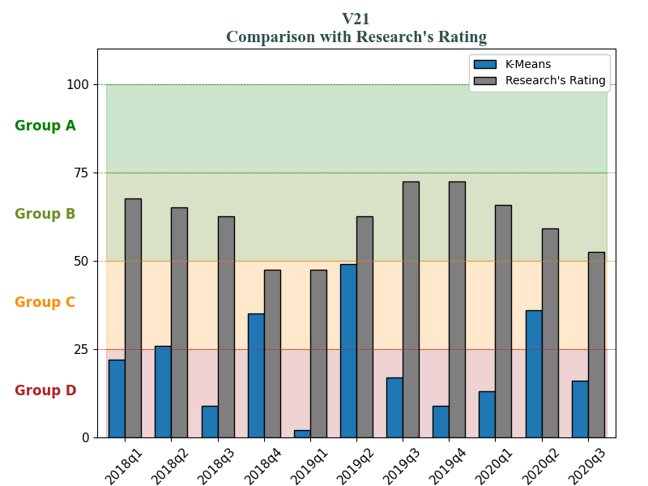
V21 dropped 75% in 2020q2

Slide 27
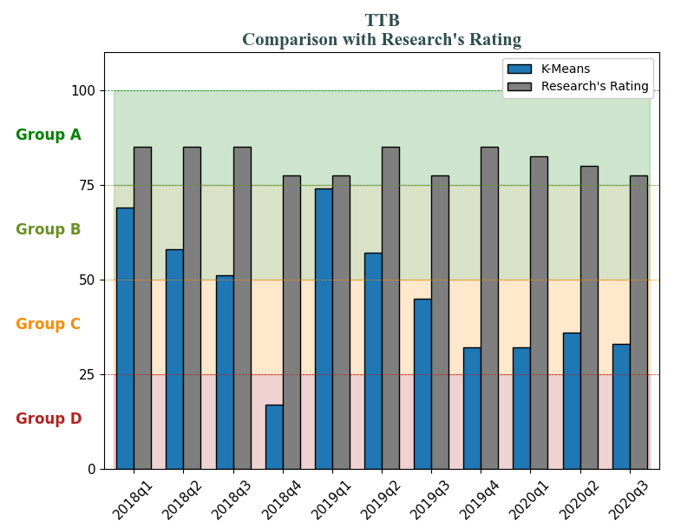
TTB dropped 75% in 2019q4

Slide 28
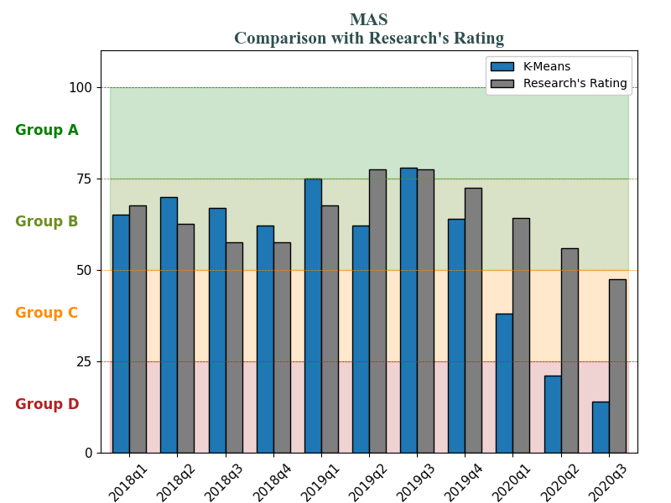
MAS dropped 50% in 2020q1

Slide 29
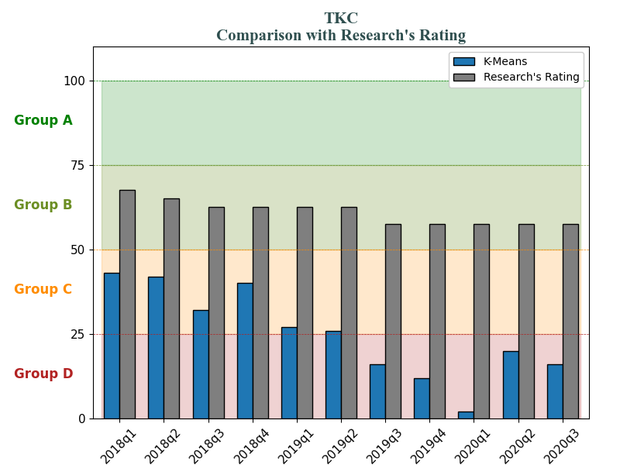
TKC dropped 85% in 2019q4

Slide 30
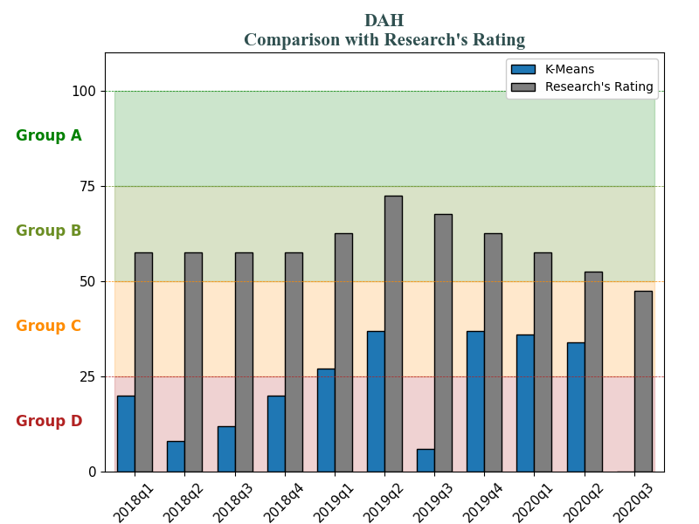
DAH dropped 80% in 2020q3

Slide 31
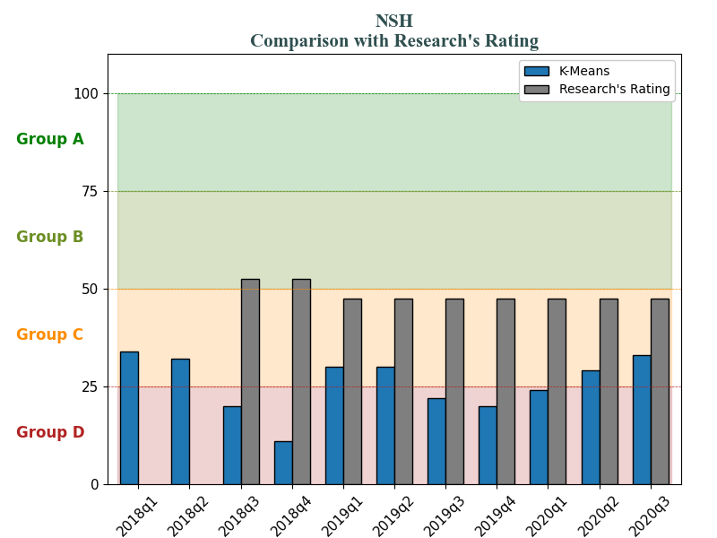
NSH dropped 80% in 2018q4

